Slide 1
AWS -2

Slide 2
Availability Zone
In a region there would be data centers which will be clustered and isolated.
Availability zone represents a data center or a cluster of data centers at one place.
2 Azones with in a region would be physically isolated from each other.
2 Azones over a private network would be connected and data transfer can be done real fast.
Edge Location : point of contact for AWS CDN service CloudFront.

Slide 3
When we deploy a resource it is recommended to deploy it in minimum to Availability Zones in a region just to make sure one will be the backup of other .

Slide 4
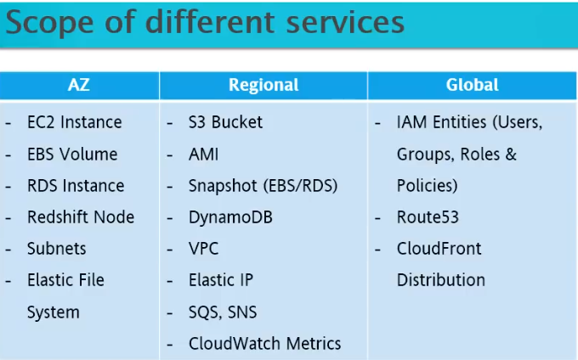

Slide 5
Service limits
There is a limit to every service over it’s scope
Limit is kept just to make sure your Paas is not giving you unlimited instances etc
Ex → we can have upto 20 ec2 instances over a region.
If we wish to increase we need to raise a support ticket for the same.

Slide 6
VPC
VPC with a Single Public Subnet
Your instances run in a private, isolated section of the AWS cloud with direct access to the Internet. Network access control lists and security groups can be used to provide strict control over inbound and outbound network traffic to your instances.
Creates:
A /16 network with a /24 subnet. Public subnet instances use Elastic IPs or Public IPs to access the Internet.

Slide 7
VPC with Public and Private Subnets
In addition to containing a public subnet, this configuration adds a private subnet whose instances are not addressable from the Internet. Instances in the private subnet can establish outbound connections to the Internet via the public subnet using Network Address Translation (NAT).
Creates:
A /16 network with two /24 subnets. Public subnet instances use Elastic IPs to access the Internet. Private subnet instances access the Internet via Network Address Translation (NAT). (Hourly charges for NAT devices apply.)

Slide 9
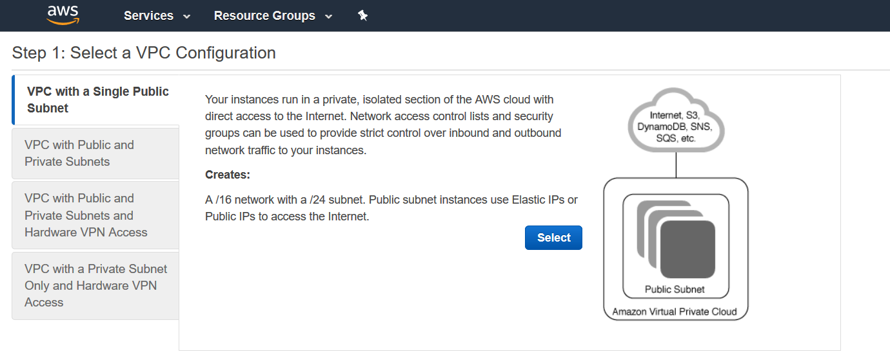

Slide 10
CIDR : set of allowable Ips
10.0.0.0/16 → will have 10 ^ (32-16) no. of Ips

Slide 11
Route table
Each VPC by default will get a route table. We can create a rout table for each subnet.
If no route table is given to subnet by default it takes main route table
One subnet can have only one route table.
One route table can be associated with multiple subnets
Internet gateway:
Allows connectivity from our VPC to outside internet
Only one internet gateway can be attached to one VPC
Right click and attach the VPC to internet gateway.
Go back to public route table and add route with internet gateway ID

Slide 12
NAT Gateway
Always keep NAT gateway in public subnet
Link it up with private route tables
NAT gateway comes into picture if your private subnets need to get some info from internet / download something from internet.

Slide 13
For public subnets make sure to enable auto assign public IPv4 address so that instances launched in these subnets get a public IP
For VPC make sure DNS Resolution & DNS Hostnames is pointed to Yes

